Slide 1

VISION-BASED HUMAN ACTIVITY RECOGNITION USING DEEP LEARNING CS5720 Neural Network & Deep Learning - Project

Slide 2
GROUP MEMBERS
NAME | ID NUMBER
ANUSHA SREE BELLI | 700758644
YASASWINI MAJETY | 700747747
BHAVANA BILLA | 700756590
RUCHITHA SURAKANTI | 700753219

Slide 3
ROLES & RESPONSIBILITIES
Anusha Sree Belli:
Collected or obtained a video collection comprising labeled human activity data.
The video data was preprocessed, including scaling, normalization, and augmentation.
Managed data pipelines and storage to allow quick access during training. Developing robust training data sets. Yasaswini Majety:
Optimized hyperparameters and loss functions to boost model performance.
Fine-tunes pre-trained models created from scratch using the dataset.
Depends on outcomes after evaluating model performance with validation and test sets.

Slide 4
ROLES & RESPONSIBILITIES
Bhavana Billa:
Created software modules that process video input streams.
Integrated the deep learning model into the software's design.
Implemented real-time inference capabilities for detecting human activity.
Ruchitha Surakanti:
Created test cases and strategies to validate the functionality of the software and model.
Performed manual and automated testing to detect flaws and issues.
Verified that the program fits the specifications and functions as expected.
Provided comments to the development team regarding issue repairs and improvements.

Slide 5
ABSTRACT
This study introduces an innovative method for vision-based human activity recognition (HAR) by leveraging Convolutional Neural Networks (CNN) and transfer learning.
HAR has gained importance in diverse fields such as elderly monitoring, anomaly identification, and security systems. Conventional machine learning methods have been surpassed by deep learning models, which can autonomously extract features while minimizing computational resources.
In our research, we employ a CNN model to identify human activities from image data sets. By applying transfer learning, we effectively obtain deep image features and train machine learning classifiers. Our experiments utilize the VGG-16 framework, achieving an impressive accuracy rate of 96.95%. Additionally, our findings highlight the enhanced performance of VGG-16 when compared to alternative CNN models used for HAR. This investigation contributes to the development of HAR techniques and presents a promising approach for vision-based activity recognition across various practical application.

Slide 6
OBJECTIVES
Developing a Robust Model
Exploring Transfer Learning
Dataset Collection and Preparation
Model Evaluation Metrics
Hyperparameter Tuning
Cross-Validation and Testing
Comparative Analysis
Real-Time Inference
Documentation and Reporting
Future Directions

Slide 7
MOTIVATION
Improving Quality of Life
Empowering Assistive Technologies
Advancing Computer Vision
Real-World Applications
Innovation and Research
Addressing Societal Needs
Learning and Growth
Potential for Impact
Project has the potential to make a meaningful difference in people's lives while also contributing to the advancement of science and technology. Stay motivated, stay curious, and enjoy the journey of discovery and innovation!

Slide 8
RELATED WORK
"Two-stream convolutional networks for action recognition in videos" by Karen Simonyan and Andrew Zisserman.
"Learning spatiotemporal features with 3D convolutional networks" by Du Tran et al.
"Self-supervised learning for human activity recognition: A comprehensive survey" by Manish Kumar and Balasubramanian Raman.
Studying these works had provided valuable insights and inspiration for our research and experimentation.

Slide 9
PROBLEM STATEMENT
Human activity recognition (HAR) plays a crucial role in various applications, including healthcare monitoring, surveillance, and human-computer interaction. Traditional methods for HAR often rely on handcrafted features and shallow learning algorithms, which may struggle to capture the complex spatiotemporal patterns present in video data.
To address this challenge, this project aims to develop an efficient and accurate vision-based human activity recognition system using transfer learning and convolutional neural networks (CNNs).

Slide 10
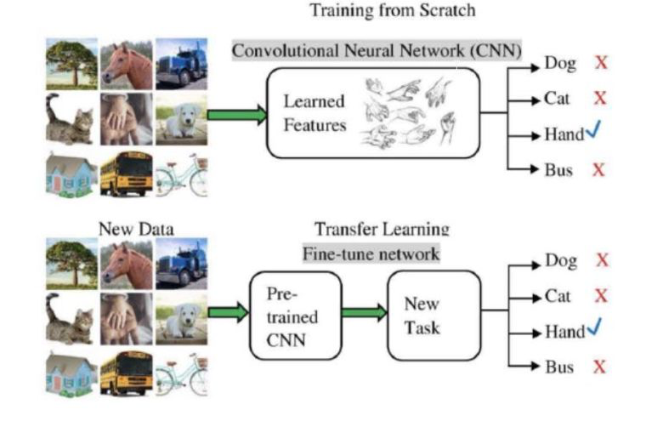
PROBLEM SOLUTION

Slide 11

RESULTS

Slide 12

RESULTS

Slide 13
REFERENCES
[1] Samundra Deep,Xi Zheng Department of Comput- ing Macquarie University “Sydney, Australia Conference” Leveraging CNN and Transfer Learning for Vision-Based Human Activity Recognition”. International Acess number:19572619.DOI:10.1109/ITNAC46935 2019.9078016. TelecommunicationNetworks and Applications Date Added toIEEE Xplore:27 April 2020 INSPEC R.
[2] T. Dobhal, V. Shitole, G. Thomas, G. Navada, Human Activity Recognition using Binary Motion Image and Deep Learning, Binary Motion Image Deep learning model gives good accuracy for both 2D and 3D datasets consistent speed of action performed by a human.
[3] R. Janarthanan, S. Doss, S. Baskar, Optimized unsupervised deep learning assisted reconstructed coder in the on-nodule wearable sensor for human activity recognition,improves the feature selection and extraction using an unsu-pervised deep learning model.

Slide 14
REFERENCES
[4] Y. Jia, Y. Guo, G. Wang, R. Song, G. Cui, X. Zhong, Multi-frequency and multi-domain human activity recognition based on SFCW radar using deep learning, Neurocomputing. Developed deep learning model ncreases the recognition accuracy by 1.3% by additionally introducing the range maps.
[5] J. Schmidhuber, “Deep Learning In Neural Networks:An Overview”, Neural Networks, vol. 61, pp. 85-117, 2015.
[6] D. C. Ciresan, U. Meier U, and L. M. Gambardella,“Deep, Big, Simple Neural Nets For Handwritten Digit Recognition”, Neural computation, vol. 22, no. 12, pp. 3207-3220, 2010.
[7] Kay W, Carreira J, Simonyan K, Zhang B, Hillier C, Vijayanarasimhan S, Viola F, Green T, Back T, Natsev P, “The Kinetics Human Action Video Dataset”, 2017.

Slide 15
REFERENCES
[8] Yu Zhao, Rennong Yang, Guillaume Chevalier, Ximeng Xu, and Zhenxing Zhang, “Deep Residual Bidir-LSTM for Human Activity Recognition Using Wearable Sensors,” Mathematical Problems in Engineering, Volume 2018.
[9] D. Das and A. Chakrabarty, “Human Gait-Based Gender Identification System Using Hidden Markov Model And Support Vector Machines,” in Conf. Comput. Commun. Autom. ICCCA 2015, pp. 268–272, 2015.
[10] N. Y. Hammerla, S. Halloran, and T. Ploetz,“Deep, Convolutional, And Recurrent Models For Hu-man Activity Recognition Using Wearables,” arXiv preprint arXiv:1604.08880, 2016.

Slide 16
THANK YOU!

